Slide 1
HTML
Instructor:
Atik Shahriar Ratul Full Stack Web developer

Slide 2
Tutorial Objectives
Explore the structure of the World Wide Web
Learn the basic principles of Web documents
Create a HTML document
View an HTML file using a Web browser
Use HTML tags for text, headings, paragraphs, and lists
Insert character tags into an HTML document
Insert an inline graphic image into a HTML document
Add special characters to an HTML document
Insert horizontal lines into an HTML document

Slide 3



How the Web Works
Page request
Server response

Slide 4
Some Basics
WWW – World Wide Web.
W3C – World Wide Web Consortium
HTML – Hyper Text Markup Language
URL – Uniform Resource Locator
Browser – A software program which is used to show web pages.
Web server: a system on the internet containing one or more web site
Web site: a collection of one or more web pages
Web pages: single disk file with a single file name
Home pages: first page in website

Slide 5
Welcome to HTML!
HTML stands for Hyper Text Markup Language.
Hypertext : Ability to create links to open the pages and their resources.
Markup : use for creating pages and formatted text along with the existing resources.
The primary author of HTML (Hyper Text Markup Language) is Tim Berners-Lee

Slide 6
Welcome to HTML!
An HTML file must have an .htm or .html file extension
HTML files can be created with text editors:
NotePad, NotePad ++, PSPad

Slide 7



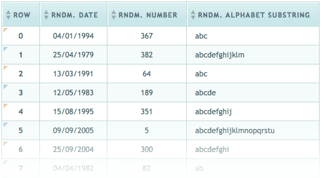

HTML Basics

Slide 8

Modern Web Design
HTML: Structure

Slide 9

Modern Web Design
HTML: Structure
CSS: Presentation

Slide 10

Modern Web Design
HTML: Structure
CSS: Presentation
JavaScript: Behavior

Slide 11
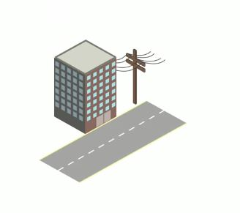
Modern Web Design
HTML: Structure
CSS: Presentation
JavaScript: Behavior
PHP or similar: Backend

Slide 12
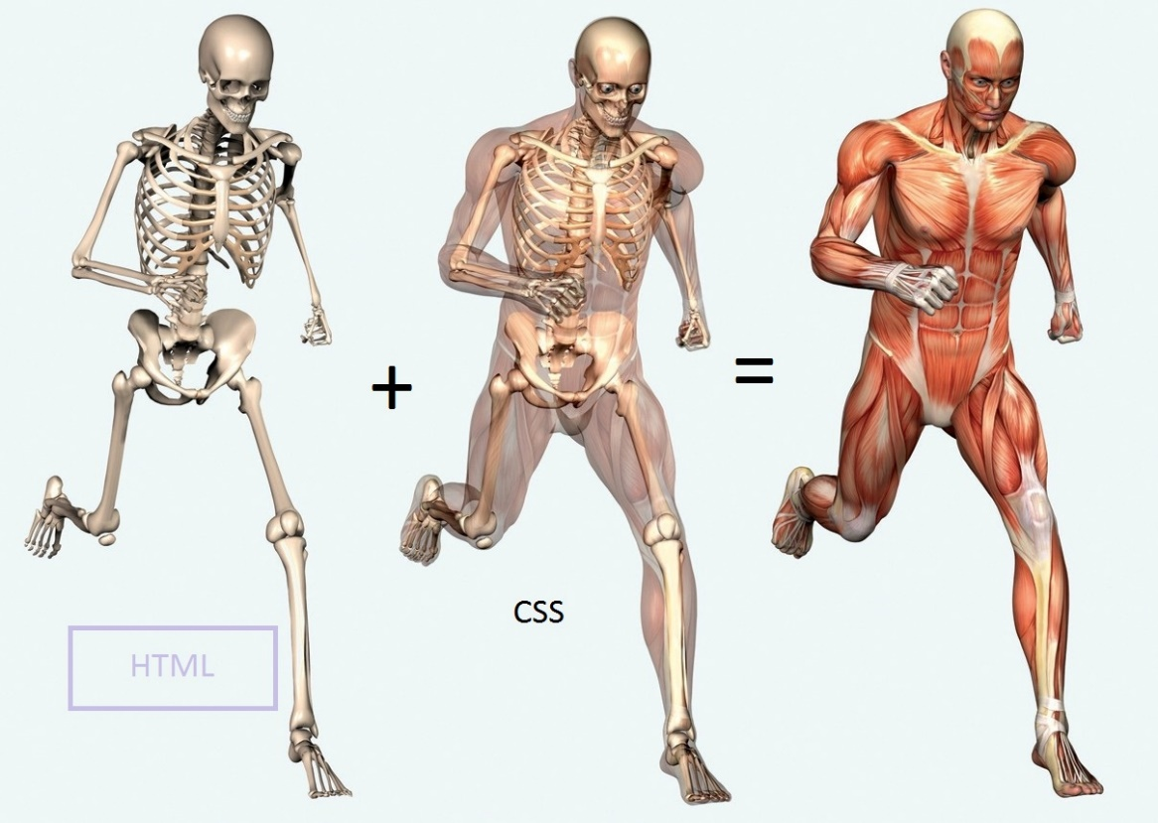
Structure

Slide 13
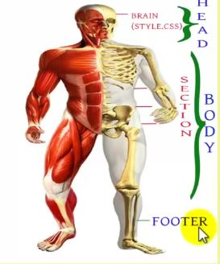

Slide 14
The <html> Tag
<html>
…………..
</html>

Slide 15
The <head> Tag
<html> <head>…</head> </html>

Slide 16
The <body> Tag
<html>
<head> ……….
</head>
<body>
………. </body>
</html>

Slide 17
Create a HTML file

Slide 18
The <title> Tag
<html>
<head> <title>first page</title> </head>
<body> This is a line of text. </body>
</html>

Slide 19
Task
Create a html File

Slide 20
The <p> Element
To create a paragraph, simply type in the <p> element with its opening and closing tags:
<html> <head> <title>first page</title> </head> <body> <p>This is a paragraph. </p> <p>This is another paragraph. </p> </body> </html>

Slide 21
Single Line Break
Use the <br /> tag to add a single line of text without starting a new paragraph:
<html> <head> <title>first page</title> </head> <body> <p>This is a paragraph.</p> <p>This is another paragraph. </p> <p>This is <br /> a line break </p> </body> </html>
******** The <br /> element is an empty HTML element. It has no end tag.

Slide 22
Formatting Elements
In HTML, there is a list of elements that specify text style. Formatting elements were designed to display special types of text:
<p>This is regular text </p>
<p><b> bold text </b></p>
<p><big> big text </big></p>
<p><i> italic text </i></p>
<p><small> small text </small></p>
<p><strong> strong text </strong></p>
<p><sub> subscripted text </sub></p>
<p><sup> superscripted text </sup></p>
<p><ins> inserted text </ins></p>
<p><del> deleted text </del></p>

Slide 23
HTML Headings
HTML includes six levels of headings, which are ranked according to importance. These are <h1>, <h2>, <h3>, <h4>, <h5>, and <h6>. The following code defines all of the headings:
<html> <head> <title>first page</title> </head> <body> <h1>This is heading 1</h1> <h2>This is heading 2</h2> <h3>This is heading 3</h3> <h4>This is heading 4</h4> <h5>This is heading 5</h5> <h6>This is heading 6</h6> </body> </html>

Slide 24
Comments
The browser does not display comments, but they help document the HTML and add descriptions, reminders, and other notes.
<!- - Your comment goes here - ->

Slide 25
Comments → Examples
<html> <head> <title>first page</title> </head> <body> <p>This is a paragraph </p> <hr /> <p>This is a paragraph </p> <! --This is a comment --> </body> </html>

Slide 26
HTML Attributes
Attributes provide additional information about an element or a tag, while also modifying them. Most attributes have a value; the value modifies the attribute.
<p align="center"> This text is aligned to center </p>

Slide 27
Attribute Measurements
As an example, we can modify the horizontal line so it has a width of 50 pixels.
This can be done by using the width attribute:
<hr width="50px" />
An element's width can also be defined using percentages:
<hr width="50%" />

Slide 28
The Align Attribute
The align attribute is used to specify how the text is aligned. In the example below, we have a paragraph that is aligned to the center, and a line that is aligned to the right.
<html> <head> <title>Attributes</title> </head> <body> <p align="center">This is a text <br /> <hr width="10%" align="right" /> This is also a text. </p> </body> </html>

Slide 29
Attributes
<p align="center"> This is a text <hr width="50%" align="left" /> </p>

Slide 30
The <img> Tag
The <img> tag is used to insert an image. It contains only attributes, and does not have a closing tag. The image's URL (address) can be defined using the src attribute. The HTML image syntax looks like this:
<img src="image.jpg" />

Slide 31
Image Location
You need to put in the image location for the src attribute that is between the quotation marks. For example, if you have a photo named "tree.jpg" in the same folder as the HTML file, your code should look like this:
<html> <head> <title>first page</title> </head> <body> <img src="tree.jpg" alt="" /> </body> </html>

Slide 32
Image Resizing
To define the image size, use the width and height attributes. The value can be specified in pixels or as a percentage:
<html> <head> <title>first page</title> </head> <body> <img src="tree.jpg" height="150px" width="150px" alt="" /> <!-- or --> <img src="tree.jpg" height="50%" width="50%" alt="" /> </body> </html>

Slide 33
Image Border
By default, an image has no borders. Use the border attribute within the image tag to create a border around the image.
<img src="tree.jpg" height="150px" width="150px" border="1px" alt="" />
The border color can be changed:
<img src="tree.jpg" height="150px" width="150px" border="1px black" alt="" />

Slide 34
The <a> Tag
Links are also an integral part of every web page. You can add links to text or images that will enable the user to click on them in order to be directed to another file or webpage. In HTML, links are defined using the <a> tag. Use the href attribute to define the link's destination address:
<a href=""></a>

Slide 35
Creating Your First Link
In the example below, a link to website is defined:
<a href="http://www.orbit-ittranning.com">Orbit</a>

Slide 36
The target Attribute
The target attribute specifies where to open the linked document. Giving a _blank value to your attribute will have the link open in a new window or new tab:
<a href=http://www.orbit-ittranning.com target="_blank" >Orbit</a>

Slide 37
HTML Ordered Lists
An ordered list starts with the <ol> tag, and each list item is defined by the <li> tag. Here is an example of an ordered list:
<html> <head> <title>first page</title> </head> <body> <ol> <li>Red</li> <li>Blue</li> <li>Green</li> </ol> </body> </html>

Slide 38
HTML Unordered List
n unordered list starts with the <ul> tag.
<html> <head> <title>first page</title> </head> <body> <ul> <li>Red</li> <li>Blue</li> <li>Green</li> </ul> </body> </html>

Slide 39
Creating a Table
Tables are defined by using the <table> tag. Tables are divided into table rows with the <tr> tag. Table rows are divided into table columns (table data) with the <td> tag.

Slide 40
Table
Here is an example of a table with one row and three columns:
<table> <tr> <td></td> <td></td> <td></td> </tr> </table>

Slide 41
The Border and Colspan Attributes
A border can be added using the border attribute:
<table border="2">
A table cell can span two or more columns:
<table border="2"> <tr> <td>Red</td> <td>Blue</td> <td>Green</td> </tr> <tr> <td><br /></td> <td colspan="2"></td> </tr> </table>

Slide 42
Colspan
The example below demonstrates the colspan attribute in action:
<table border="2"> <tr> <td>Red</td> <td>Blue</td> <td>Green</td> </tr> <tr> <td>Yellow</td> <td colspan="2">Orange</td> </tr> </table>

Slide 43
The align and bgcolor Attributes
To change your table's position, use the align attribute inside your table tag:
<table align="center">
Now let's specify a background color of red for a table row. To do that, just use the bgcolor attribute. <table border="2">
<tr> <td bgcolor="red">Red</td> <td>Blue</td> <td>Green</td> </tr> <tr> <td>Yellow</td> <td colspan="2">Orange</td> </tr> </table>

Slide 44
Inline and Block Elements

Slide 45
Types of Elements
In HTML, most elements are defined as block level or inline elements. Block level elements start from a new line. For example: <h1>, <form>, <li>, <ol>, <ul>, <p>, <pre>, <table>, <div>, etc. Inline elements are normally displayed without line breaks. For example: <b>, <td>, <a>, <strong>, <img>, <input>, <em>, <span>, etc. <div> and <span> elements can be used as containers for other HTML elements.

Slide 46
Types of Elements
Other elements can be used either as block level elements or inline elements. This includes the following elements: APPLET - embedded Java applet IFRAME - Inline frame INS - inserted text MAP - image map OBJECT - embedded object SCRIPT - script within an HTML document

Slide 47
Forms

Slide 48
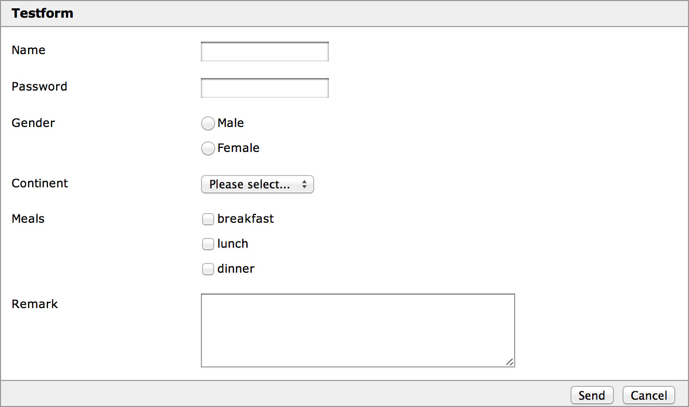

Slide 49
The <form> Element
HTML Forms are used to collect information from the user. Forms are defined using the <form> element, with its opening and closing tags:
<body> <form>…</form> </body>
Use the action attribute to point to a webpage that will load after the user submits the form.
<form action=“action.php"> </form>

Slide 50
The method and name Attributes
The method attribute specifies the HTTP method (GET or POST) to be used when forms are submitted (see below for description):
<form action="url" method="GET"> <form action="url" method="POST"> When you use GET, the form data will be visible in the page address.
Use POST if the form is updating data, or includes sensitive information (passwords). POST offers better security because the submitted data is not visible in the page address.

Slide 51
The method and name Attributes
The name attribute specifies a name for a form. To take in user input, you need the corresponding form elements, such as text fields. The <input> element has many variations, depending on the type attribute. It can be a text, password, radio, URL, submit, etc. The example below shows a form requesting a username and password:<form> <input type="text" name="username" /><br /> <input type="password" name="password" />

Slide 53
Form Elements
If we change the input type to radio, it allows the user select only one of a number of choices:
<input type="radio" name="gender" value="male" />Male <br /> <input type="radio" name="gender" value="female" />Female <br />

Slide 54
Form Elements
The type "checkbox" allows the user to select more than one option:
<input type="checkbox" name="gender" value="1" />Male <br /> <input type="checkbox" name="gender" value="2" />Female <br />

Slide 55
Form Elements
The submit button submits a form to its action attribute:
<input type="submit" value="Submit" />

Slide 56
<fieldset>
The <fieldset> element groups related data in a form.
The <legend> element defines a caption for the <fieldset> element.

Slide 57
<fieldset>
<form action="action_page.php"> <fieldset> <legend>Personal information:</legend> First name:<br> <input type="text" name="firstname" value="Mickey"> <br> Last name:<br> <input type="text" name="lastname" value="Mouse"> <br><br> <input type="submit" value="Submit"> </fieldset> </form>

Slide 58
The <select> Element (Drop-Down List)
<form >
my car:<br>
<select name="cars">
<option value="volvo">Volvo</option>
<option value="saab">Saab</option>
<option value="fiat">Fiat</option>
<option value="audi">Audi</option>
</select>
<br><br>
<input type="submit">
</form>

Slide 59
Date
<form> Birthday: <input type="date" name="bday"> </form>

Slide 60
Color
<form> Select your favorite color: <input type="color" name="favcolor"> </form>

Slide 61
email
<form> E-mail: <input type="email" name="email"> </form>

Slide 62
url
<form> Add your homepage: <input type="url" name="homepage"> </form>

Slide 63
HTML Colors!
HTML colors are expressed as hexadecimal values. 0, 1, 2, 3, 4, 5, 6, 7, 8, 9, A, B, C, D, E, F

Slide 64

HTML Color Model
Colors are displayed in combinations of red, green, and blue light (RGB). Hex values are written using the hashtag symbol (#), followed by either three or six hex characters. As shown in the picture below, the circles overlap, forming new colors:

Slide 65
Background and Font Colors
The bgcolor attribute can be used to change the web page's background color. This example would produce a dark blue background with a white headline:
<html> <head> <title>first page</title> </head> <body bgcolor="#000099"> <h1> <font color="#FFFFFF">White headline</font> </h1> </body> </html>

Slide 66
Home Task
Must Be Done Before Next Class.
Submit the Home Task

